Slide 1
Microcontroller Results
Joshua Feldman

Slide 2
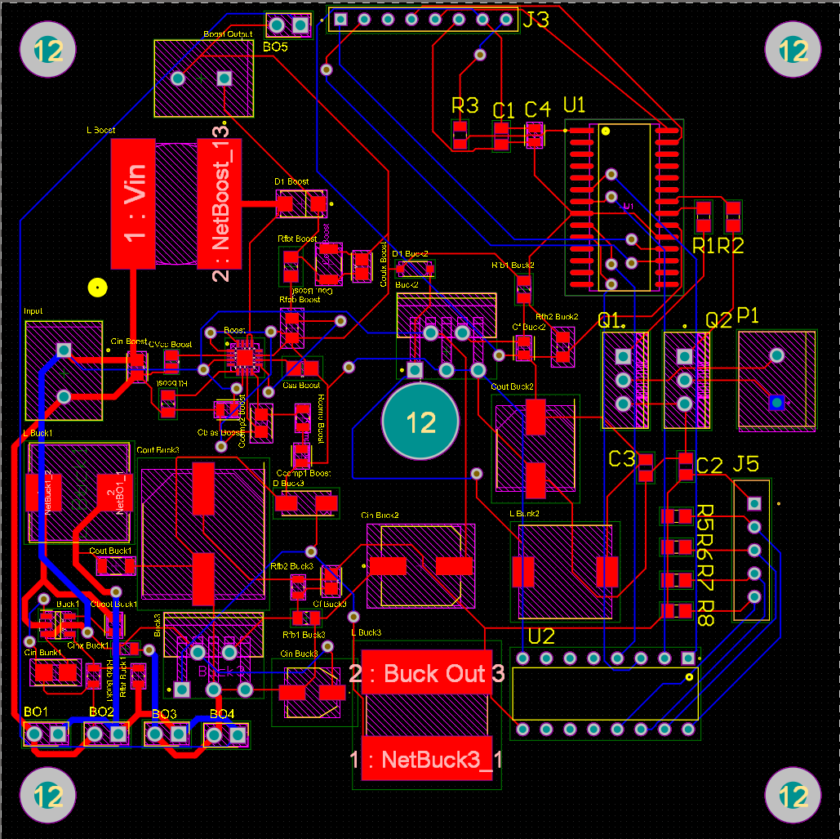
Integrated PCB Footprint

Slide 3
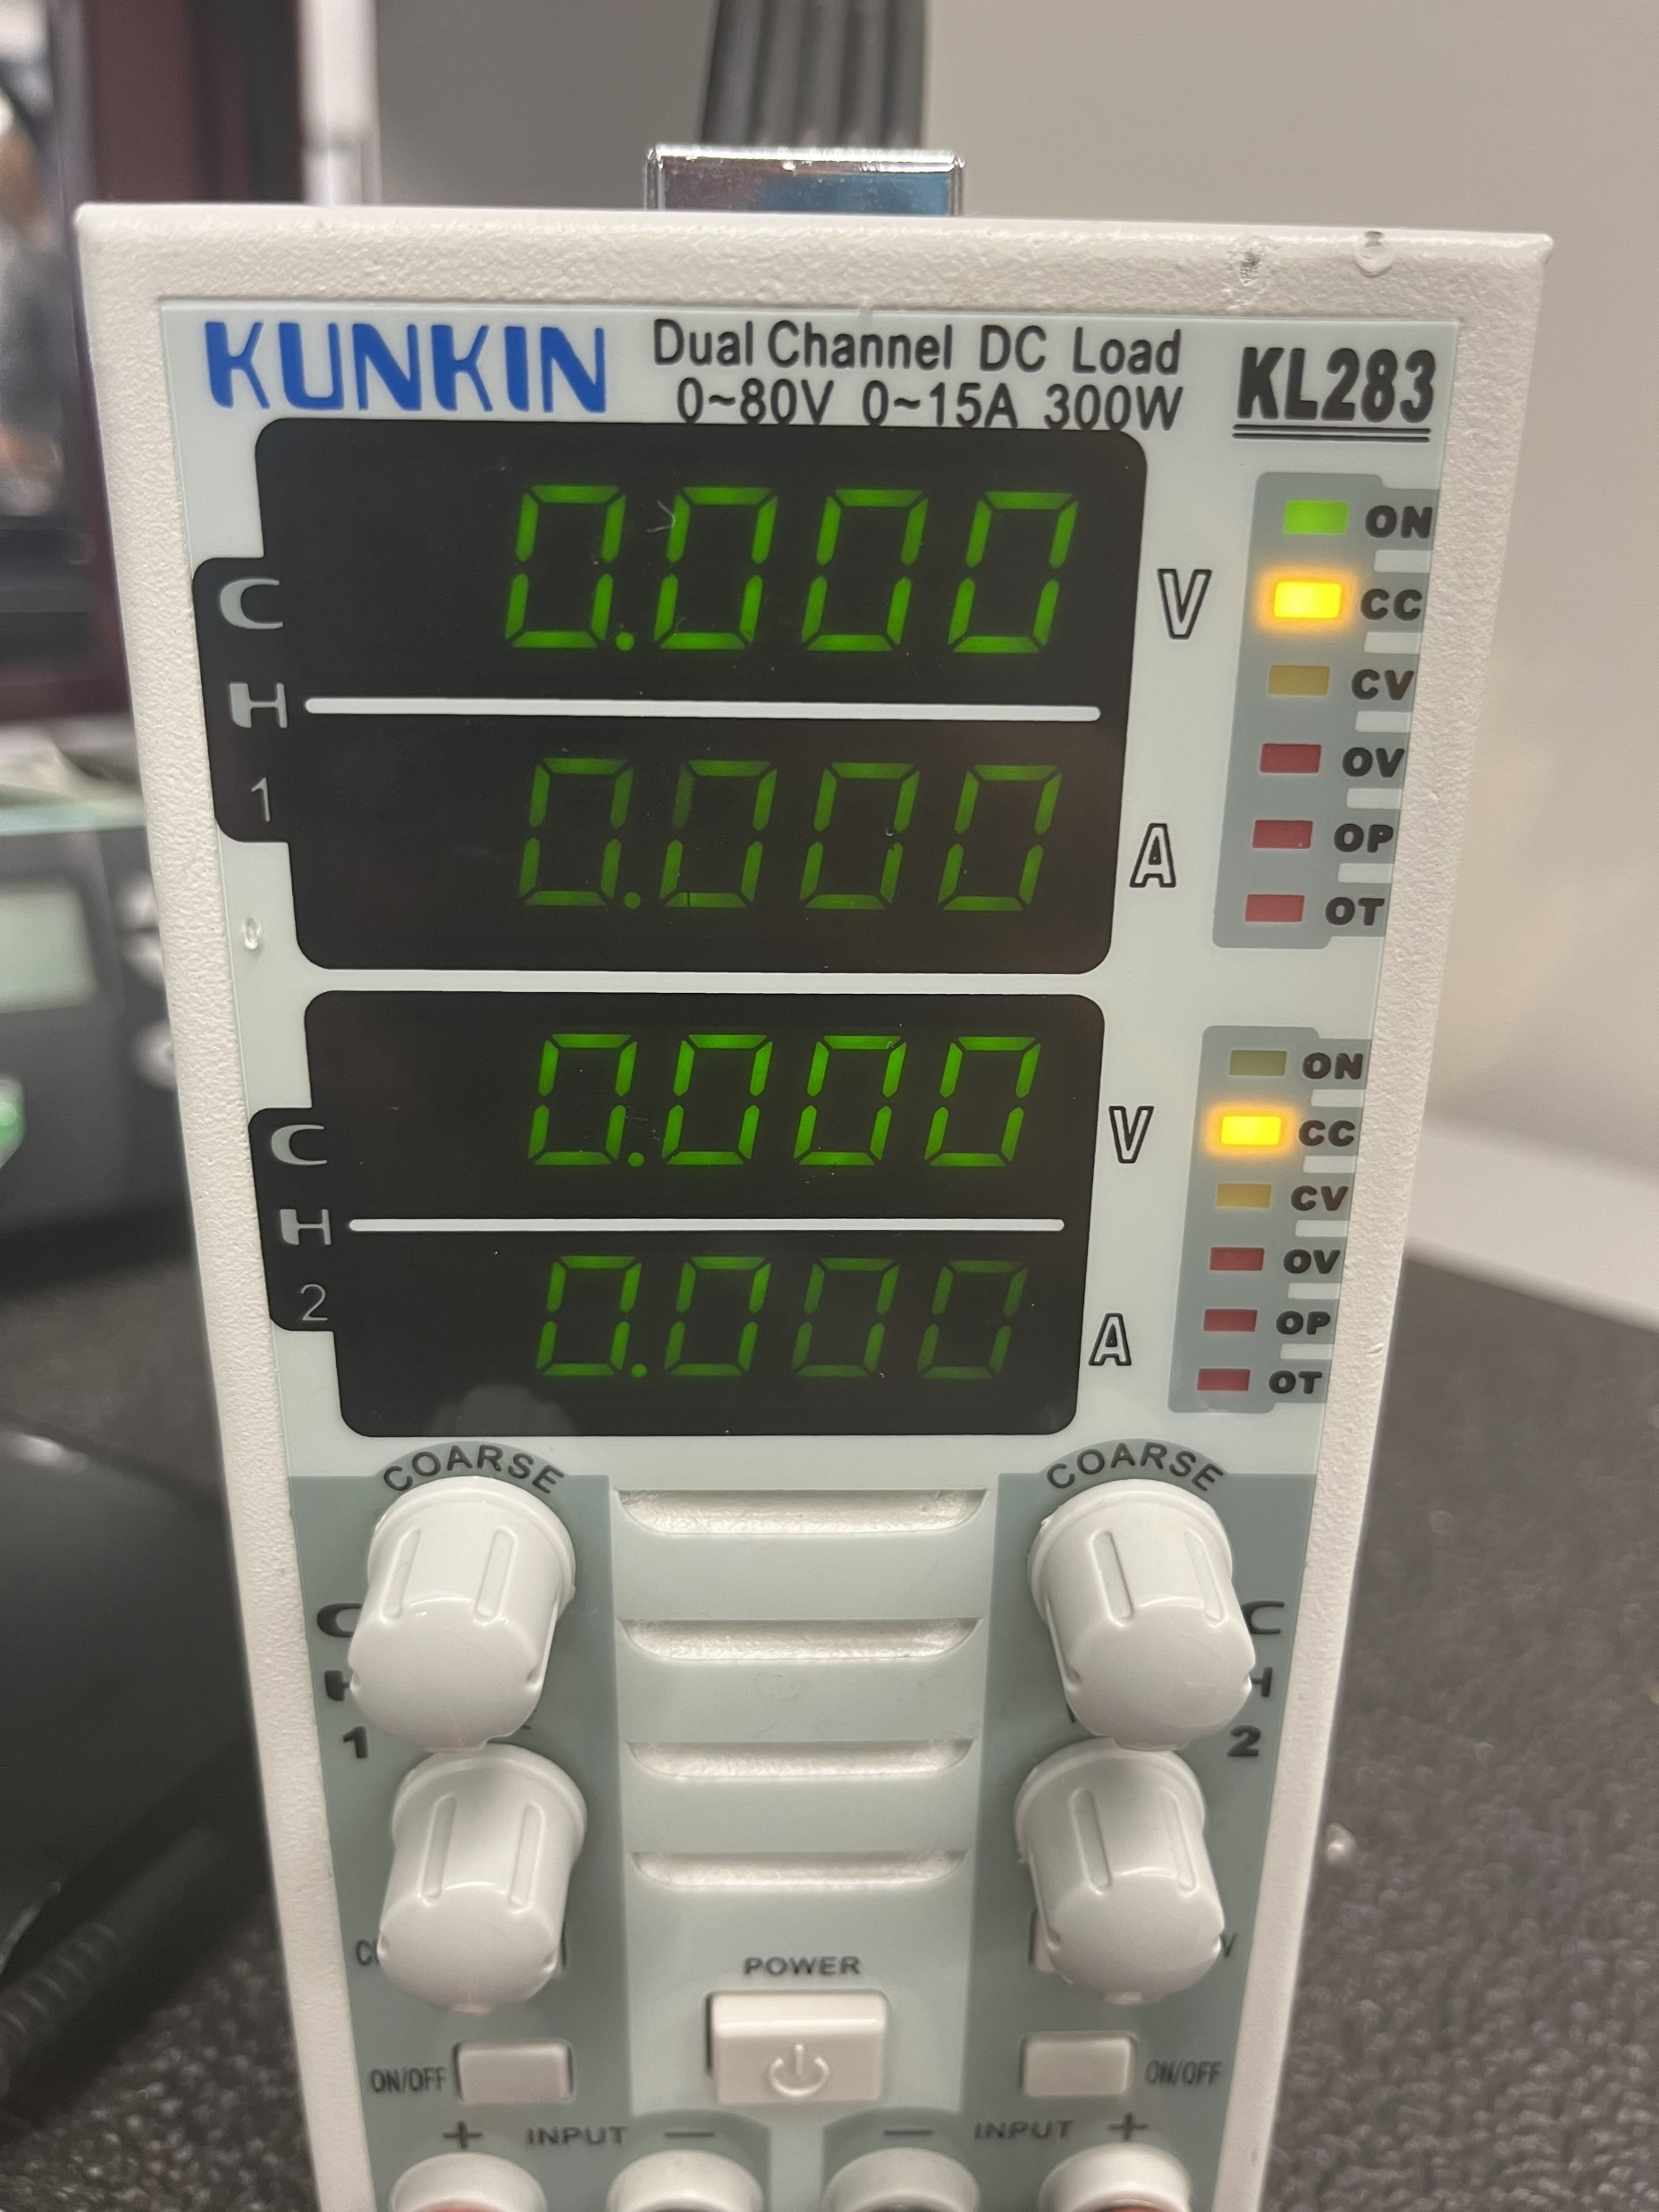
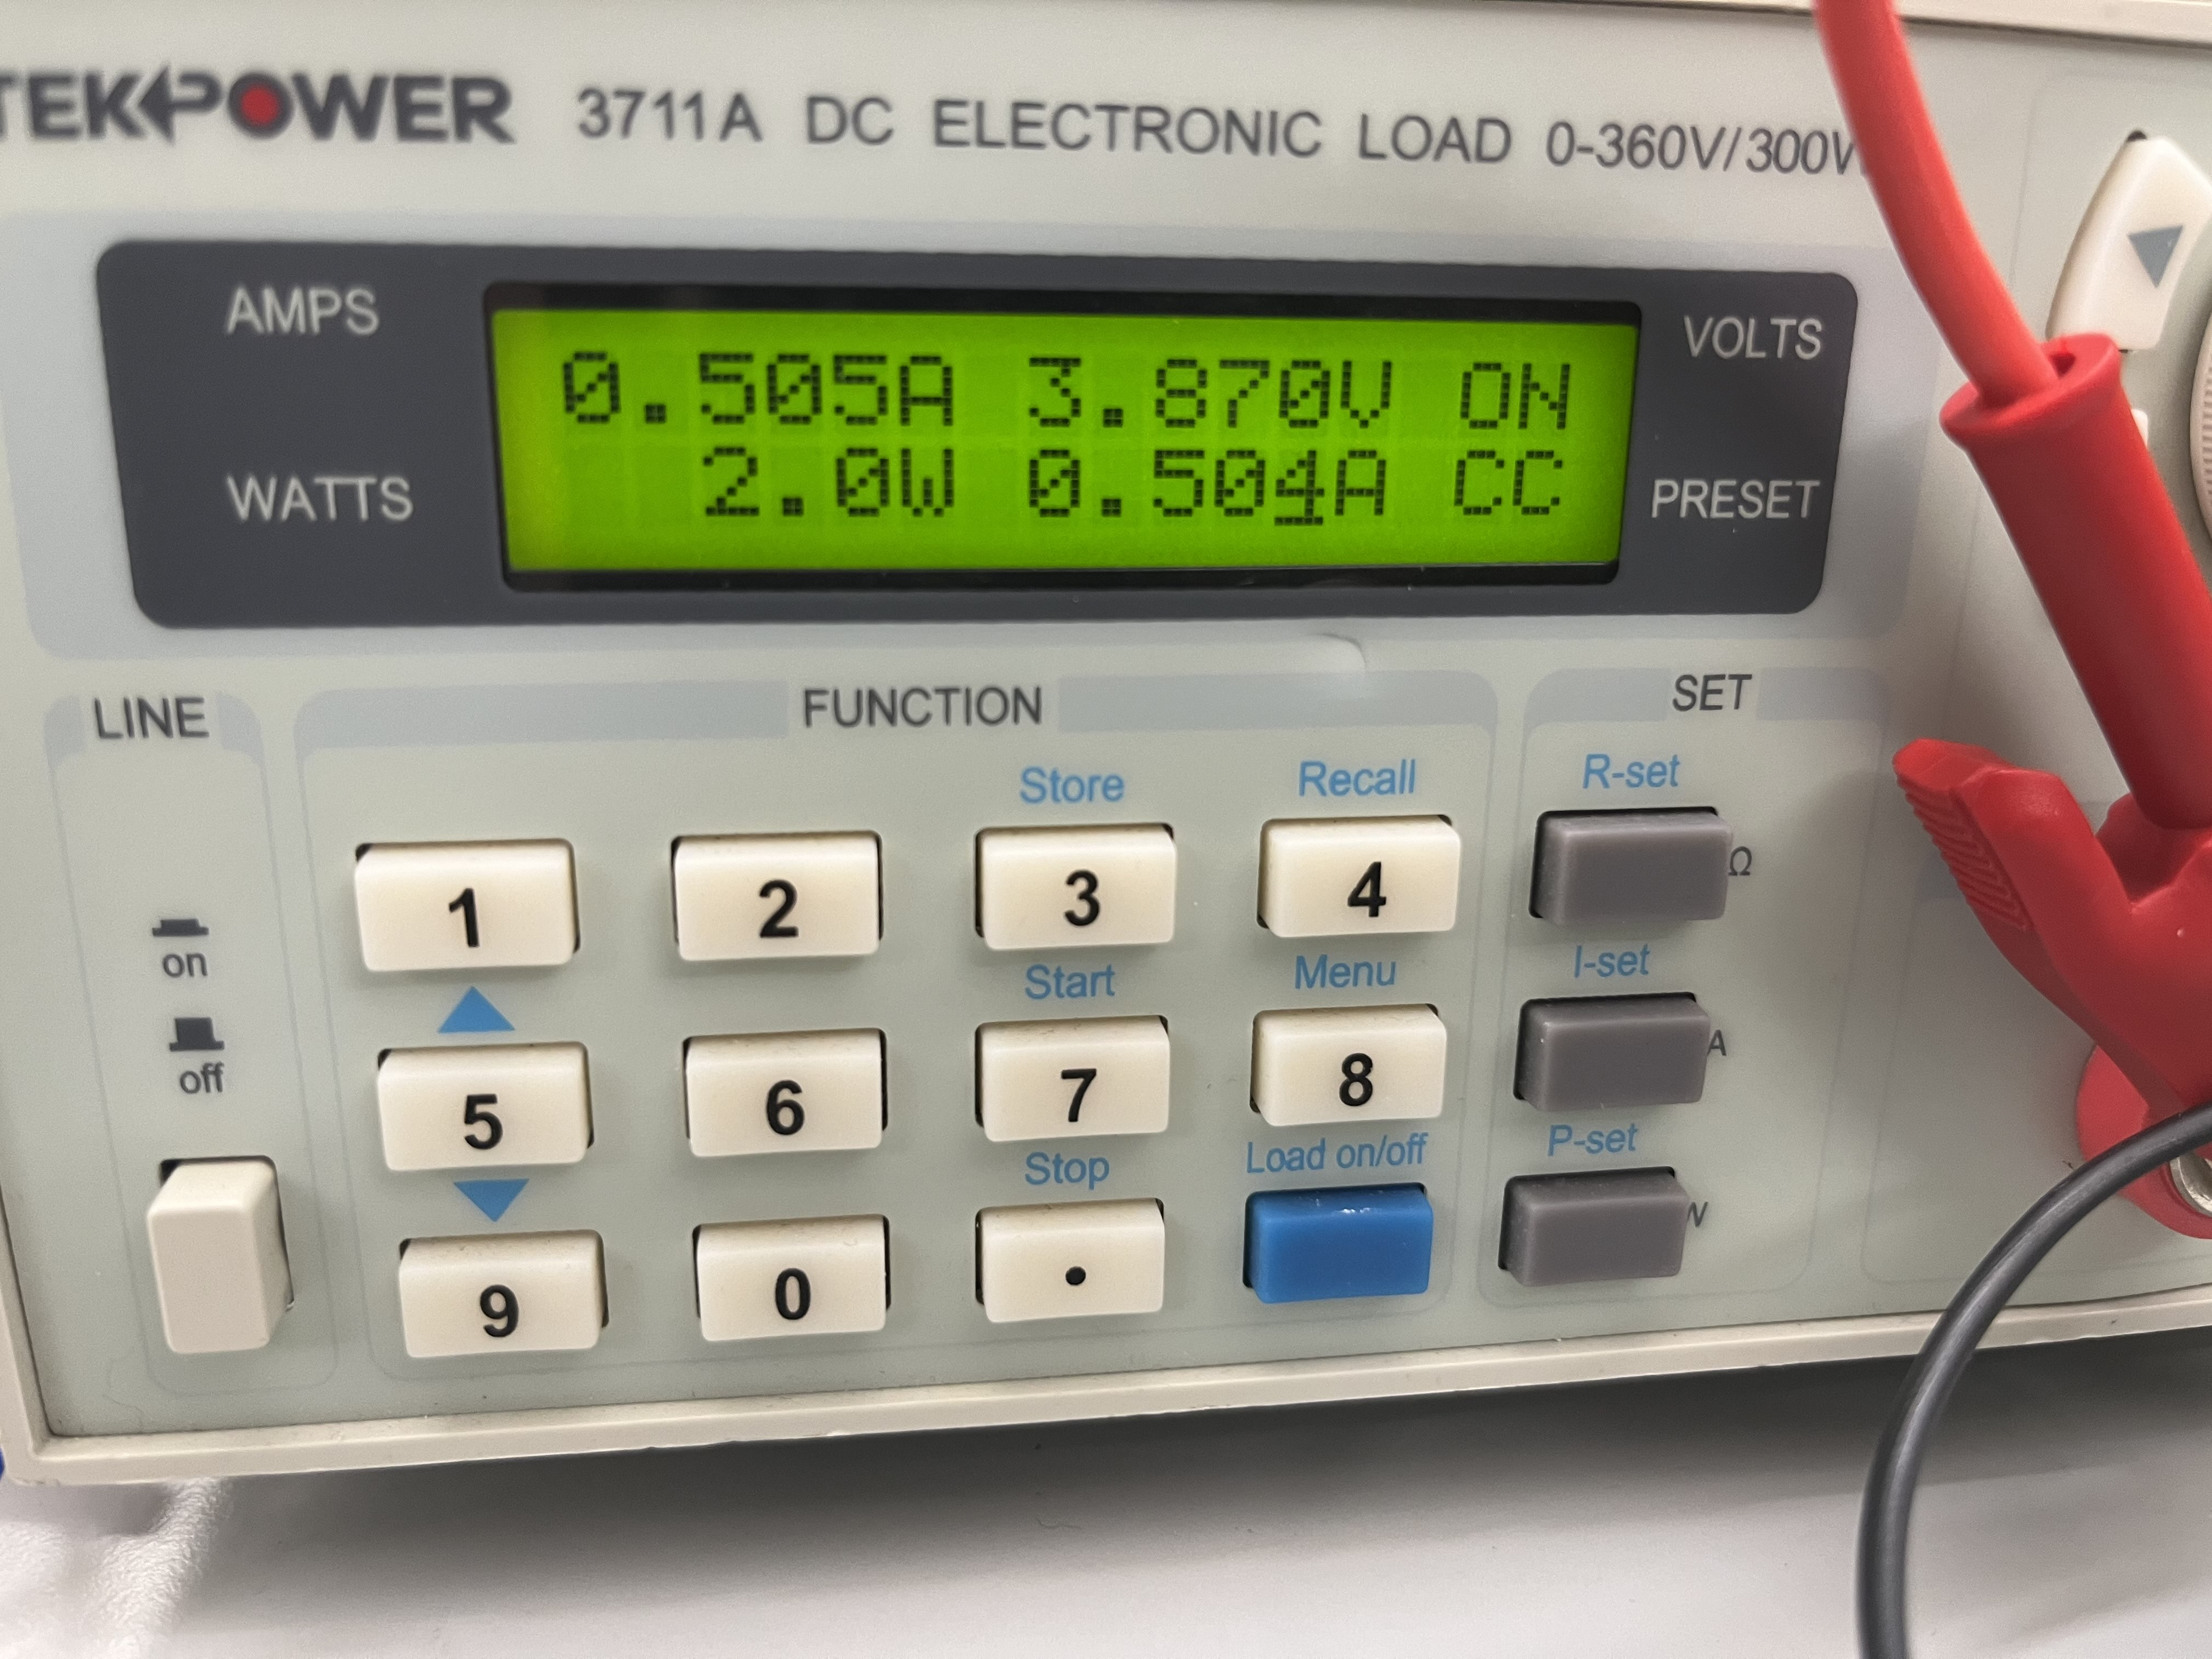
Switch 1 E-load testing Switch Enabled Switch Disabled

Slide 4
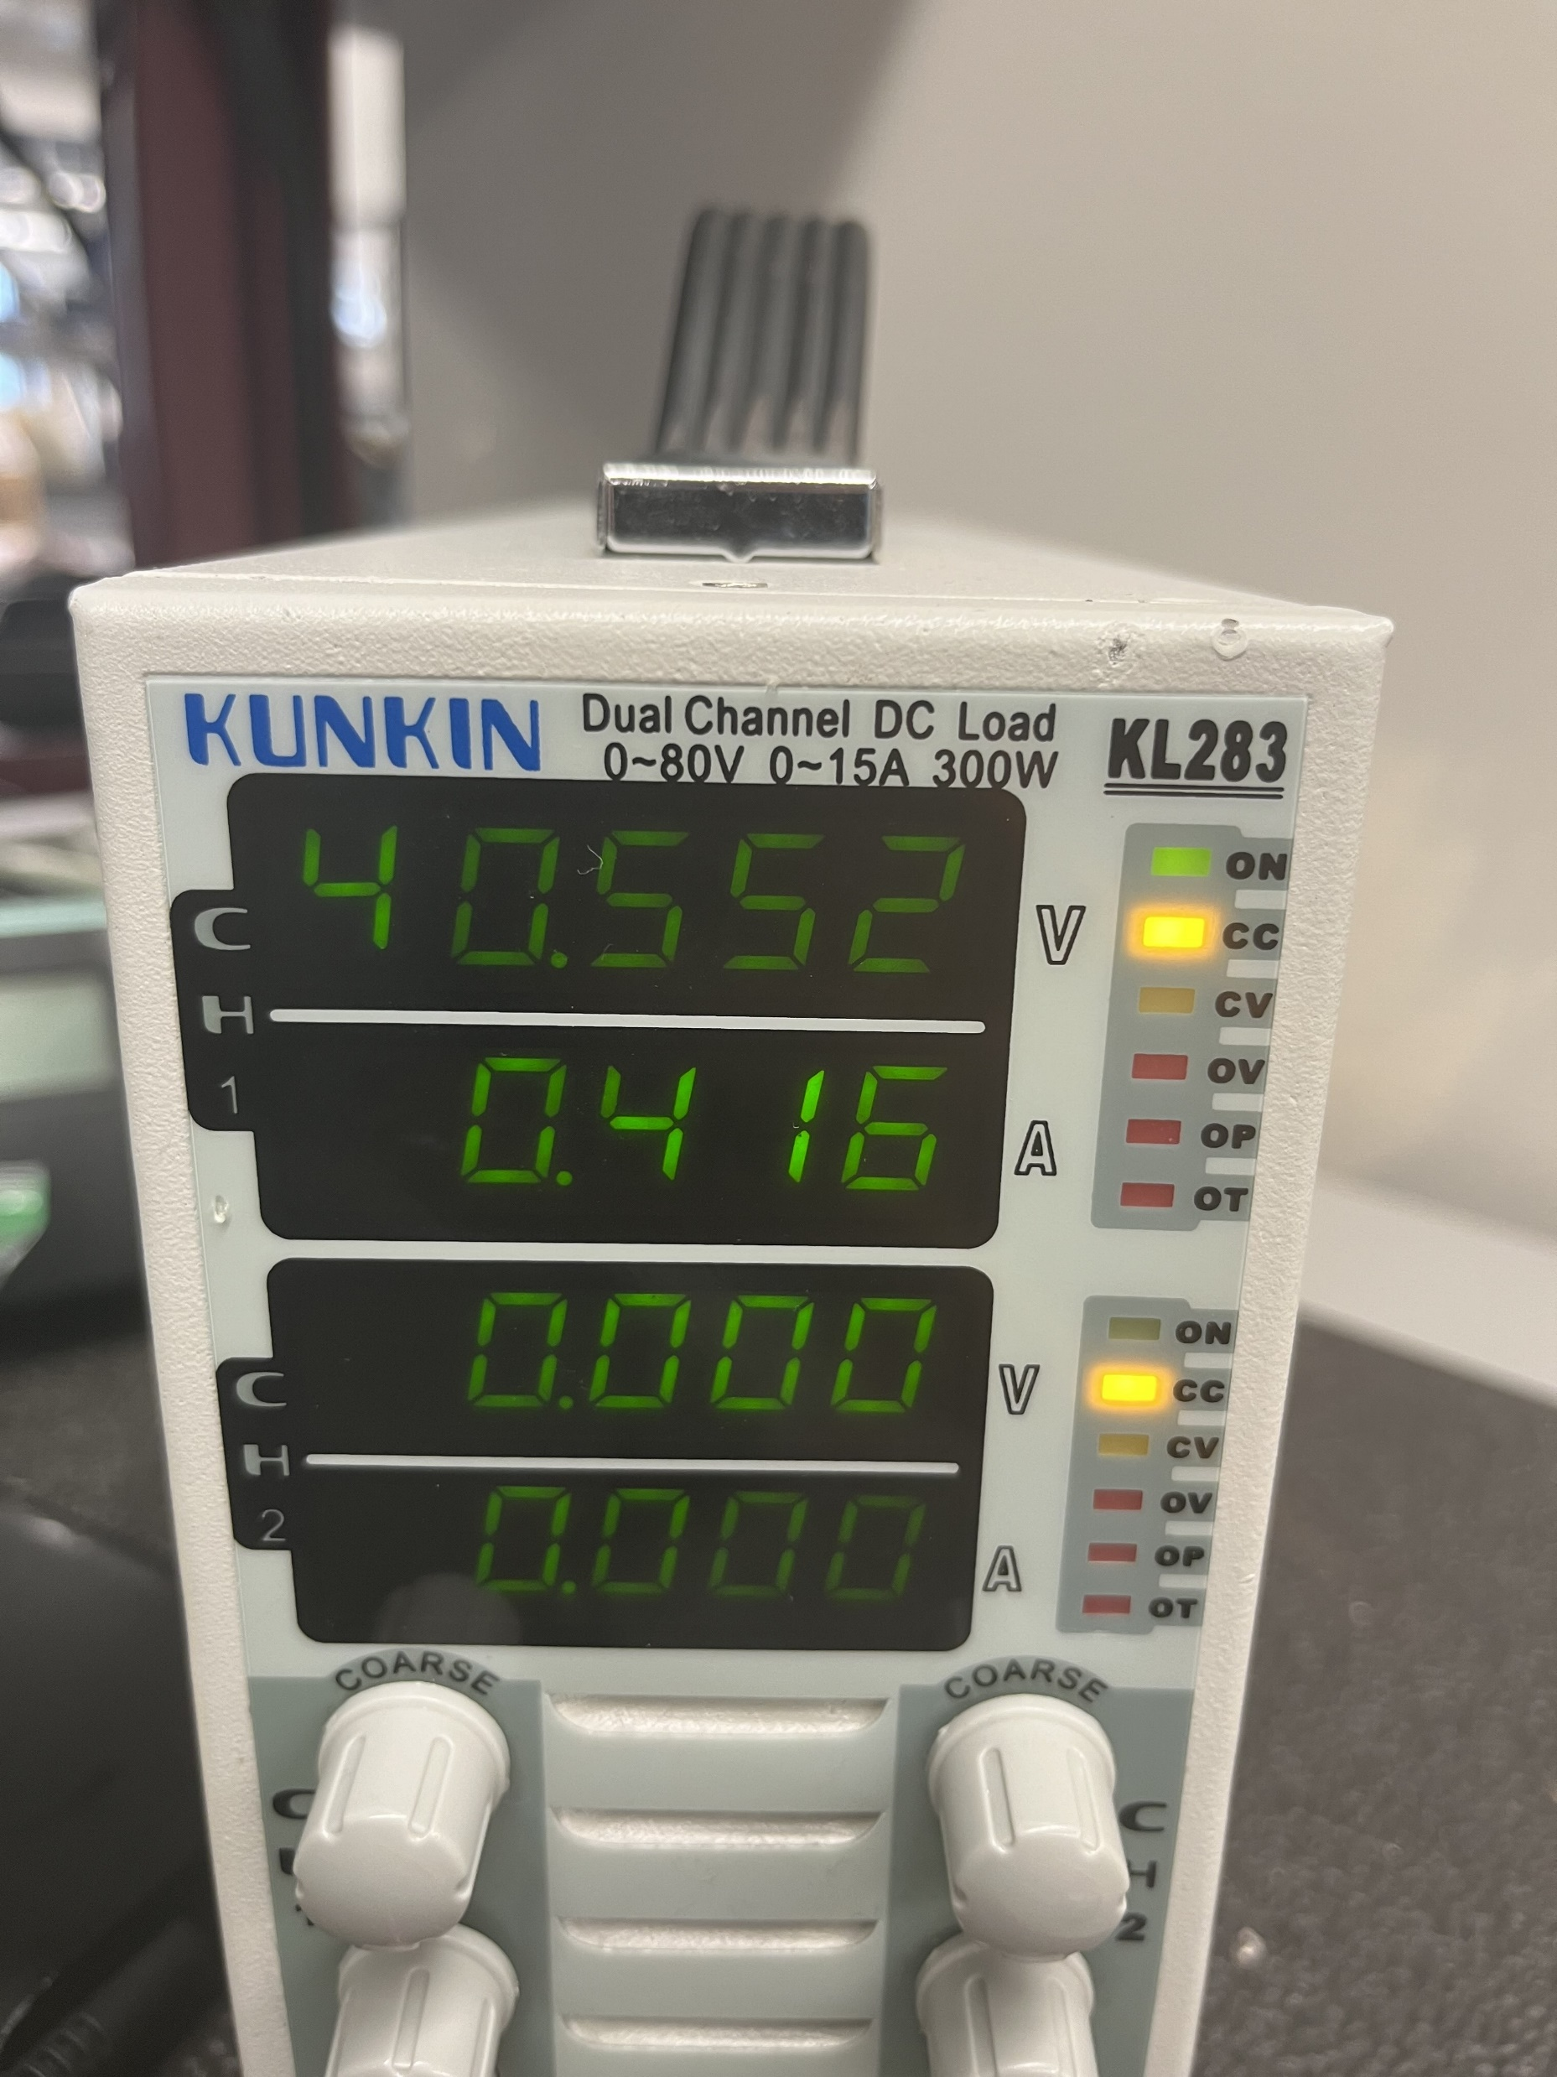
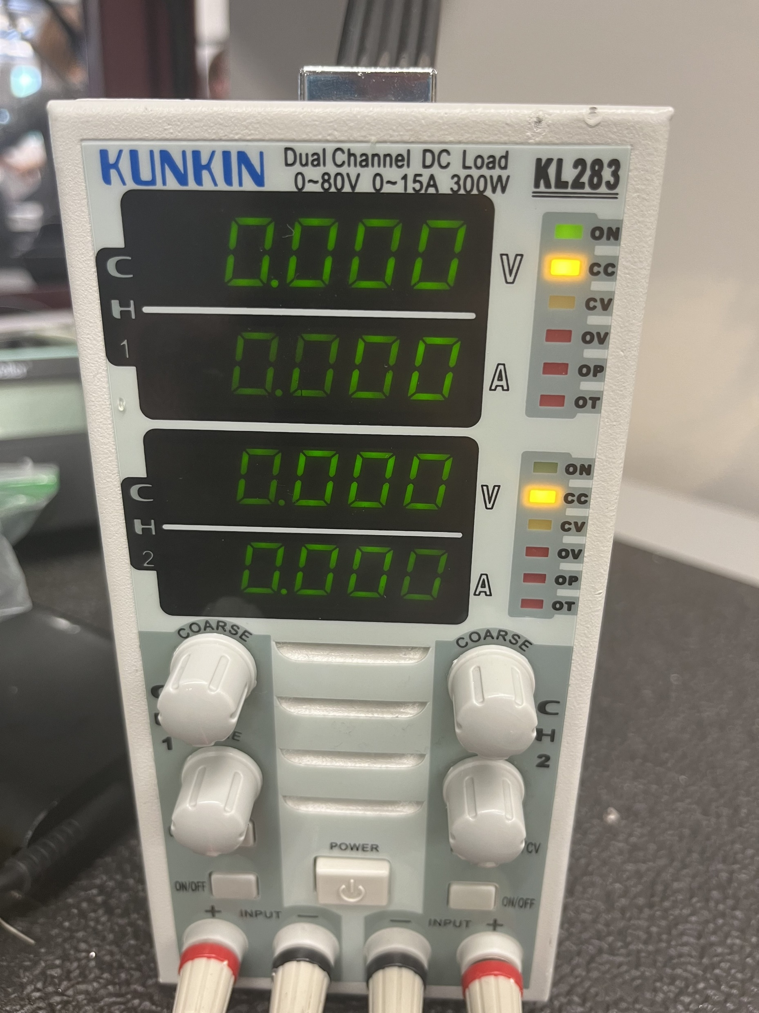
Switch 2 E-load testing Switch Enabled Switch Disabled

Slide 5
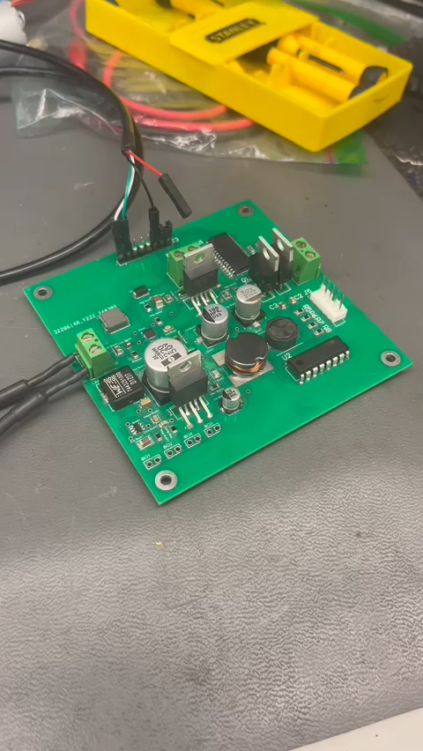
Microcontroller Functionality with USART

Slide 6
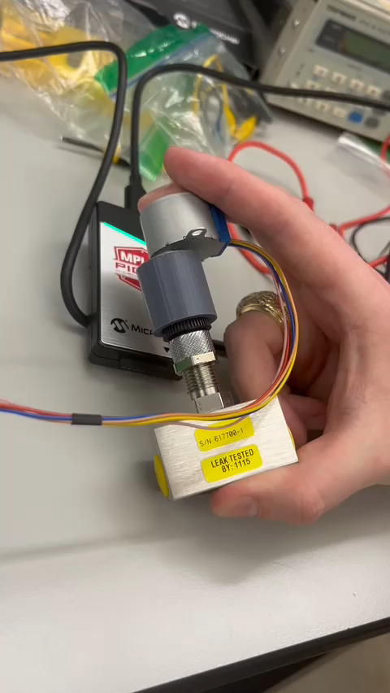
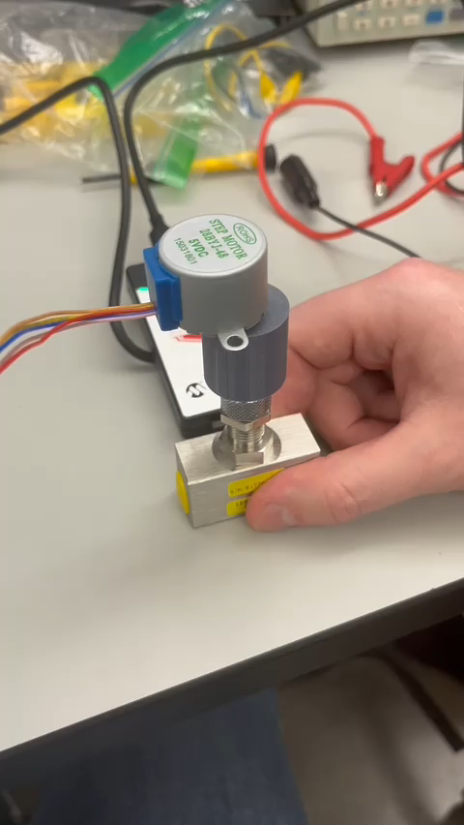
Stepper Motor Control Turning Valve Handle Attempting to Turn Past Limit

